Slide 1
WELCOME

Slide 2
SLEEP HEALTH & LIFE STYLE
ANALYSIS REPORT
POWER BI PROJECT REPORT :
SUBMITED BY,
KEERTHANA PV

Slide 3
TABLE OF CONTENTS
Introduction
Objectives
Dataset Overview
Datasets
Criteria Used
Dashboard
Conclusion
Future Scope
References

Slide 4
INTRODUCTION
Sleep is a critical pillar of health, alongside diet and exercise — yet a large share of adults report poor sleep quality linked to lifestyle and occupational stress.
This project analyzes the Sleep Health and Lifestyle Dataset, which records sleep patterns, physical activity, stress levels, and cardiovascular indicators for 374 individuals across 11 occupations.
Poor sleep has been associated with conditions such as Insomnia and Sleep Apnea, and with elevated blood pressure and heart rate — making it valuable to examine how daily habits connect to these outcomes.
This report uses Power BI to explore those relationships, and to build an interactive dashboard summarizing the key patterns found in the data.
Notes:
Sleep is the important factor of our life if we don't get enough sleep it affect our physical and mental health,To analyse this dataset I understand that outoff 374 people many of them have sleeping disorder because of their duration of sleep

Slide 5
OBJECTIVE
To analyse the relationship between lifestyle factors — physical activity, stress, and occupation — and sleep health outcomes, and to build an interactive
Power BI dashboard that highlights key patterns in sleep quality, sleep disorders, and cardiovascular health across the surveyed population.
Notes:
The primary goal of this project is to analyze how physical activity, occupational stress, and daily habits impact sleep outcomes. Additionally, we built an interactive Power BI dashboard to deliver actionable visual insights into sleep quality, disorders, and overall cardiovascular health.

Slide 6
DATASET OVERVIEW
The Sleep Health and Lifestyle Dataset comprises close to 400 rows and 13 columns, covering a wide range of variables related to sleep and daily habits — including gender, age, occupation, sleep duration, quality of sleep, physical activity level, stress levels, BMI category, blood pressure, heart rate, daily steps, and the presence or absence of sleep disorders.
Comprehensive Sleep Metrics: Sleep duration, quality, and the factors influencing sleep patterns
Lifestyle Factors: Physical activity levels, stress levels, and BMI categories
Cardiovascular Health: Blood pressure and heart rate measurements
Sleep Disorder Analysis: Occurrence of disorders such as Insomnia and Sleep Apnea
Notes:
Our dataset structure begins with the core Sleep Performance Metrics table. This view tracks individual participant IDs alongside demographic attributes like gender, age, and occupation. Crucially, it records both quantitative measurements—such as daily sleep duration in hours—and qualitative metrics, including subjective sleep quality ratings and clinical diagnoses for disorders like Insomnia and Sleep Apnea.

Slide 7
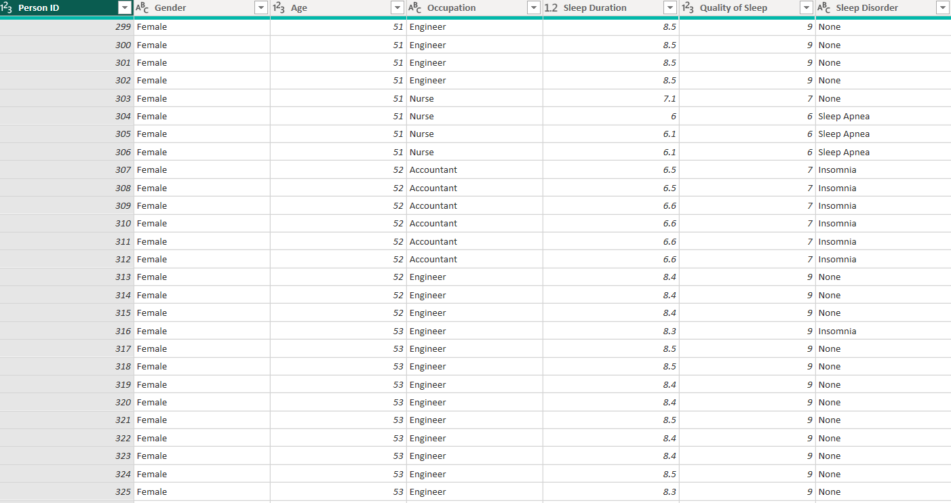
DATASET
Sleep Performance Metrix

Slide 8
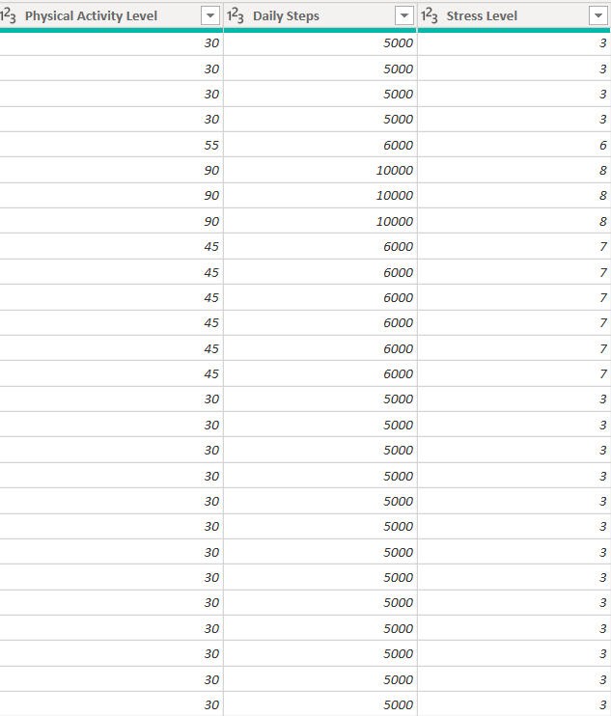
DATASET
Daily Lifestyle & Behaviors

Slide 9
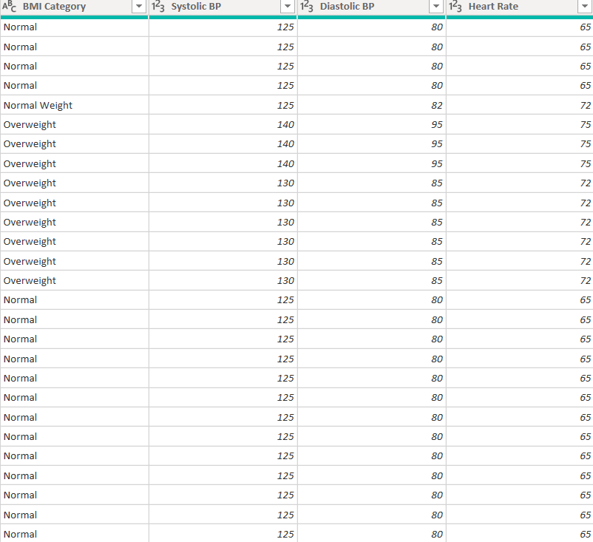
DATASET
Cardiovascular & Physical Health

Slide 10
KEY DETAILS
Sleep Performance Overview
Person ID & Participant Count: Covers 374 total respondents, assigned unique numeric identifiers from 1 to 374
Age Range: Participants range from 27 to 59 years old.
Occupational Background: Spans 11 distinct professions, led by Nurses (73), Doctors (71), Engineers (63), and Lawyers (47).
Sleep Duration: Daily sleep ranges from 5.8 to 8.5 hours, averaging 7.13 hours per day across the sample.
Quality of Sleep: Subjective quality ratings on a 1–10 scale range from 4 to 9, with a mean rating of 7.31/10.
Sleep Disorder: Categorizes participants into None (219 people | 58.6%), Sleep Apnea (78 people | 20.9%), and Insomnia (77 people | 20.6%).

Slide 11
KEY DETAILS
Daily Lifestyle & Behaviors Details
Physical Activity Level: Ranges from 30 to 90 minutes per day, with an average of 59.2 minutes.
Daily Steps: Varies between 3,000 and 10,000 steps per day, averaging 6,817 steps.
Stress Level: Rated on a 1–10 scale, ranging from 3 to 8, with an overall average stress score of 5.39.

Slide 12
KEY DETAILS
Cardiovascular & Physical Health Details
BMI Category: Classifies respondents into Normal/Normal Weight (216 people), Overweight (148 people), and Obese (10 people).
Blood Pressure: Measures Systolic (115 to 142 mmHg) and Diastolic (75 to 95 mmHg) pressures.
Heart Rate: Resting heart rate ranges from 65 to 86 beats per minute (bpm), with an average of 70.2 bpm.

Slide 13
CRITERIA USED — Charts
Sleep Disorder Breakdown (Donut Chart): Visualizes the proportion of individuals with None, Sleep Apnea, and Insomnia.
Avg Sleep Duration by Occupation (Bar Chart): Ranks average sleep duration across all 11 occupations .
Physical Activity vs. Sleep Quality (Scatter Chart): Explores the correlation between daily physical activity levels and subjective sleep quality scores.

Slide 14
CRITERIA USED — Charts
Stress & Sleep Quality by Age Group (Clustered Column Chart): Compares average stress levels alongside average sleep quality across age bands
% Hypertensive by BMI Category (Bar Chart): Displays the percentage of individuals categorized as hypertensive across Normal, Overweight, and Obese BMI levels.
Occupation Summary (Table with Color Scale): Summarizes occupational metrics including average stress level, sleep duration, and disorder percentages.

Slide 15
CRITERIA USED — Cards & Slicers
KPI Cards:
Total People: 374
Avg Sleep Duration: 7.13 hr
Avg Sleep Quality: 7.3 / 10 (or 7.31 / 10)
% With Sleep Disorder: 41.4%
Slicers:
Gender: Filters the report by Male and Female.
Age Group: Filters the report by age ranges (20-29, 30-39, 40-49, 50-59).

Slide 16
CRITERIA USED — DAX Measures
Total People: DISTINCTCOUNT('Sleep'[Person ID])
Avg Sleep Duration: AVERAGE('Sleep'[Sleep Duration])
Avg Sleep Quality: AVERAGE('Sleep'[Quality of Sleep])
Avg Stress Level: AVERAGE('Sleep'[Stress Level])
% With Sleep Disorder: DIVIDE(CALCULATE(COUNTROWS('Sleep'), 'Sleep'[Sleep Disorder Display]<>"None"), [Total People])
% Hypertensive: DIVIDE(CALCULATE(COUNTROWS('Sleep'), 'Sleep'[BP Category]="Hypertensive"), [Total People])
Notes:
Behind the visuals, dynamic Power BI DAX measures drive the analytics. We constructed distinct aggregation measures using DISTINCTCOUNT and AVERAGE to calculate sample size, mean sleep duration, quality, and stress levels. Additionally, conditional DAX calculations using DIVIDE and CALCULATE dynamically compute key percentages, such as the proportion of participants with sleep disorders and those falling into hypertensive blood pressure categories.

Slide 17
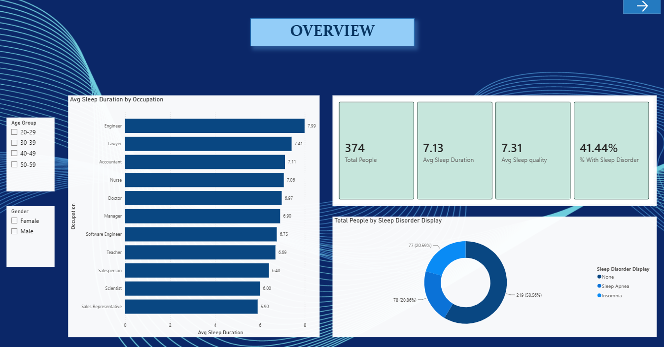
DASHBOARD

Slide 18
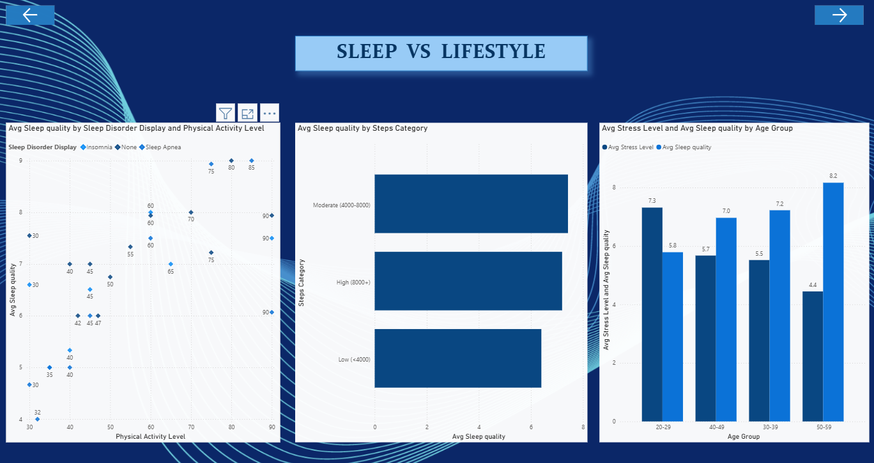
DASHBOARD

Slide 19
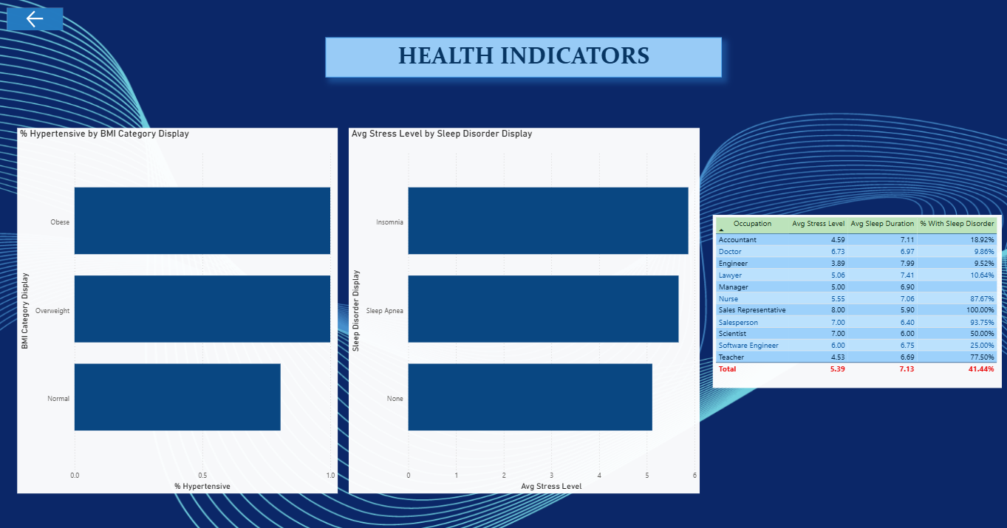
DASHBOARD

Slide 20
CONCLUSION
High Sleep Disorder Prevalence: 41.4% of respondents report a sleep disorder, divided almost equally between Sleep Apnea and Insomnia.
Stress Drives Poor Sleep: Stress level shows a strong -0.90 negative correlation with sleep quality, marking it as the single biggest factor influencing sleep outcomes.
Significant Occupational Gap: Sleep duration varies drastically by profession, ranging from 7.99 hours for Engineers down to 5.90 hours for Sales Representatives—a 2.1-hour gap.
Weight Impacts Blood Pressure: 88.8% of all participants fall into the hypertensive blood pressure category, reaching 100% for individuals in Overweight and Obese BMI categories.
Notes:
In conclusion, four key findings define this project. First, sleep disorders are widespread, affecting 41.4% of the surveyed population. Second, stress is the single strongest negative driver of sleep quality, exhibiting a -0.90 correlation. Third, an occupation sleep gap of 2.1 hours exists between high- and low-sleeping professions. Finally, elevated BMI directly increases cardiovascular risk, reaching a 100% hypertension rate among overweight and obese participants.

Slide 21
FUTURE SCOPE
Expand the dataset to track participants over extended timeframes to analyze seasonal variations, long-term health trends, and intervention effectiveness.
Develop machine learning models to predict an individual's likelihood of developing Insomnia or Sleep Apnea based on daily habits and physiological metrics.
Build automated Power BI alert systems and DAX metrics that flag high-stress, low-activity occupational profiles for early workplace wellness interventions.

Slide 22
REFERENCES
Kaggle :
[kaggle.com/datasets/uom190346a/sleep-health-and-lifestyle-dataset]
(https://kaggle.com/datasets/uom190346a/sleep-health-and-lifestyle-dataset)
Visualization : Microsoft Power BI

Slide 23
THANK YOU

